Slide 1

AI for Finance: Graduate Course in the Fintech Master's Program
Cüneyt Gürcan Akçora
Depts. of Finance and Computer Science
University of Central Florida
Notes:
1

Slide 2
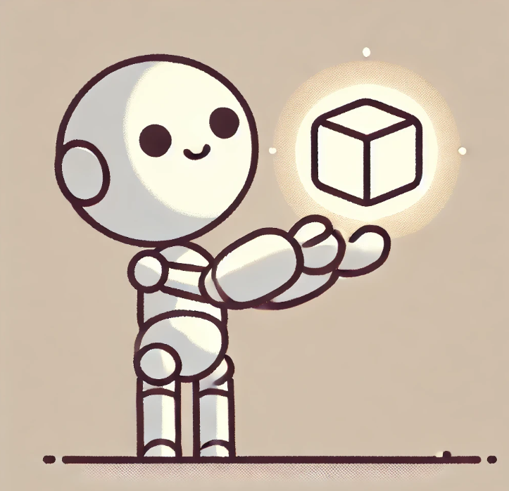
Today
Hardware for AI
Intelligence types
Machine Learning
ML code examples

Slide 3
Form of Intelligence
Artificial narrow intelligence (ANI): This specifies an AI agent that exceeds human-expert-level capabilities and skills in a narrow field. AlphaZero can be considered an ANI in Go, chess, and shogi. An algorithmic stock-trading AI agent that realizes a net return of consistently 100% per year on the invested capital could be considered an ANI.
Artificial general intelligence (AGI) : This specifies an AI agent that reaches human-level intelligence in any field, such as chess, mathematics, text composition, or finance, and might exceed human-level intelligence in some other domains.
Superintelligence (SI) : This specifies an intellect or AI agent that exceeds human-level intelligence in any respect.

Slide 4
An ANI can reach a complex goal in a narrow field on a level higher than any human.
An AGI is equally as good as any human being in achieving complex goals in a wide variety of fields.
Finally, a superintelligence is significantly better at achieving complex goals in almost any conceivable field than any human being or even a collective of human beings.

Slide 5
Singularity
The fact that there are many paths that lead to superintelligence should increase our confidence that we will eventually get there. If one path turns out to be blocked, we can still progress. Nick Bostrom (2014)
There are multiple definitions for the term technological singularity. Its use dates back at least to the article by Vinge (1993), which the author provocatively begins like this:
Within thirty years, we will have the technological means to create superhuman intelligence. Shortly after, the human era will be ended.
Technological singularity refers to a point in time at which certain machines achieve superhuman intelligence or superintelligence.
The expression of technological singularity itself originates in the concept of singularity in physics. It refers to the center of a black hole, where mass is highly concentrated, gravitation becomes infinite, and traditional laws of physics break down.
The beginning of the universe, the so-called Big Bang, is also called a singularity.

Slide 6
Hardware
The first major hardware push in AI came from GPUs.
Although developed originally to generate fast high-resolution graphics for computer games, modern GPUs can be used for many other purposes as well.
One of these other purposes involves linear algebra (for example, in the form of matrix multiplication), a mathematical discipline of paramount importance for AI in general and neural networks in particular.
In modern computing, two pivotal components—Central Processing Units and Graphics Processing Units—collaborate to execute a wide array of tasks, each excelling in specific operations due to their distinct architectures and functionalities.

Slide 7
Hardware
Central Processing Unit (CPU): Often referred to as the computer's "brain, " the CPU is a general-purpose processor responsible for executing a broad spectrum of tasks.
It comprises a few powerful cores optimized for sequential processing, enabling efficient handling of complex computations and logical operations.
CPUs manage system operations, run applications, and coordinate communication between computer components.
In a typical laptop, the central processing unit usually features between 2 to 8 cores, with 4 to 6 cores being standard in mid-range models.

Slide 8
Hardware
Graphics Processing Unit (GPU): GPUs are specialized processors designed to handle tasks involving parallel processing, mainly graphics and image rendering.
They consist of thousands of smaller, efficient cores capable of performing multiple operations simultaneously, making them ideal for rendering high-resolution images, processing videos, and executing complex algorithms in parallel.
Most laptops come with an integrated GPU built into the CPU, sufficient for standard computing needs.
However, laptops designed for gaming or professional graphics work often include a dedicated GPU from manufacturers like NVIDIA or AMD, enhancing performance in graphics-intensive applications.
While integrated GPUs share system memory, dedicated GPUs have their own video memory (you will see this as VRAM on ads), for improved graphics performance.

Slide 9
High Performance Computing
We use a different set of GPUs in our AI research: HPC GPUs
HPC GPUs: Engineered to handle complex computational tasks such as scientific simulations, data analysis, and machine learning. These GPUs prioritize double-precision floating-point performance (FP64) and are optimized for parallel processing workloads.
Most importantly, HPC GPUs are supported by specialized drivers and software ecosystems tailored for computational workloads, such as NVIDIA's CUDA platform, facilitating the development of parallel applications.
https://rci.research.ucf.edu/resource/newton/

Slide 10
Hardware – a summary
CPUs have a limited number of powerful cores optimized for single-threaded performance, while GPUs possess a vast number of smaller cores designed for parallelism.
CPUs excel at serial processing, managing tasks that require sequential execution. In contrast, GPUs are adept at parallel processing, efficiently handling multiple tasks concurrently.
CPUs manage various tasks including running operating systems, executing application logic, and handling complex calculations. GPUs are tailored for tasks that benefit from parallel processing, such as graphics rendering, video processing, and accelerating machine learning computations.
CPUs are ideal for general-purpose computing tasks, system management, running applications, and executing complex algorithms that require sequential processing.
GPUs are essential for rendering graphics in gaming and professional design, accelerating video editing and processing, and enhancing performance in parallel computing tasks like machine learning and scientific simulations.

Slide 11
Types of Data
Data has two major components:
Features data (or input data) is data that is given as input to an algorithm. In a financial context, this might be, for example, the income and the savings of a potential debtor.
Labels data (or output data) is data that is given as the relevant output to be learned, for example, by a supervised learning algorithm. In a financial context, this might be the creditworthiness of a potential debtor.

Slide 12
Types of learning
There are three major types of learning algorithms: unsupervised, supervised and reinforcement learning.
Unsupervised learning are algorithms that learn from a given sample data set of features (input) values only, often with the goal of finding structure in the data.
They are supposed to learn about the input data set, given, for example, some guiding parameters.
Clustering algorithms fall into that category. In a financial context, such algorithms might cluster stocks into certain groups.

Slide 13
Types of learning
Supervised learning (SL) are algorithms that learn from a given sample data set of features (input) and labels (output) values.
Examples are ordinary least-squares regression and neural networks.
Supervised learning aims to learn the relationship between the input and output values.
In finance, such algorithms might be trained to predict whether a potential debtor is creditworthy. For this book, these are the most important types of algorithms.

Slide 14
Types of learning
Reinforcement learning (RL) algorithms learn from trial and error by receiving a reward for taking an action.
They update an optimal action policy according to what rewards and punishments they receive.
Such algorithms are, for example, used for environments where actions must be taken continuously, and rewards are received immediately, such as in a computer game.
Let’s see some of these examples.
Contd in the notebook

Slide 15
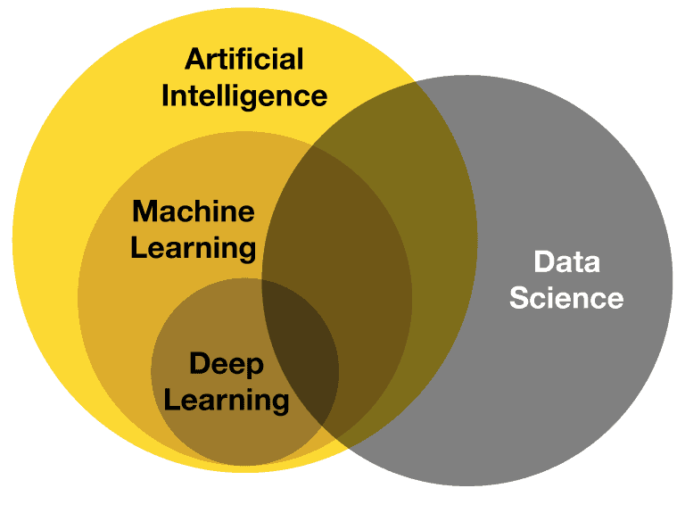
AI, ML and Data Science
Machine learning inherently involves data (experience), while artificial intelligence does not necessarily require data.
An example of an AI method that is not machine learning is rule-based systems (often called expert systems). These systems operate based on predefined rules and logic rather than learning from data.
Image: https://www.deviq.io/

Slide 16

Thanks for attending!
Cuneyt.Akcora@ucf.edu

Slide 17
Local Search
Local search algorithms are very effective in solving many Constraint Satisfaction Problems.
They use a complete-state formulation where each state assigns a value to every variable, and the search changes the value of one variable at a time.
Consider the 8-queens problem: we start with a complete assignment that will possibly violate several constraints.

Slide 18


1
Random initialization

Slide 19

2
2
2
1
2
3
1
2
Select a queen and see the vertical violations

Slide 20
3
Move the queen to the least attacked position

Slide 21
4
Second queen is not attacked – leave it as it is

Slide 22
3
5
3
2
3
2
3
0
Move the third queen to its least attacked position

Slide 23
6
Complete solution!!

